Slide 1

Safety-Critical Systems
Computers that protect our lives every day

Slide 2


What are they?
These are computer systems where a mistake is not okay.
If they break, it could cause:
Injuries or death
Damage to nature
Loss of property

Slide 3

Why they matter
Failure can hurt people, damage expensive tools, or harm the environment.
Because of this, we cannot let these systems fail.

Slide 4






How Engineers Keep Us Safe
Working Right
Safe State
Finding Dangers
Ensuring the system works perfectly during normal times.
If something breaks, the system moves to a safe "stop" mode.
Looking for and stopping risks before they happen.

Slide 5

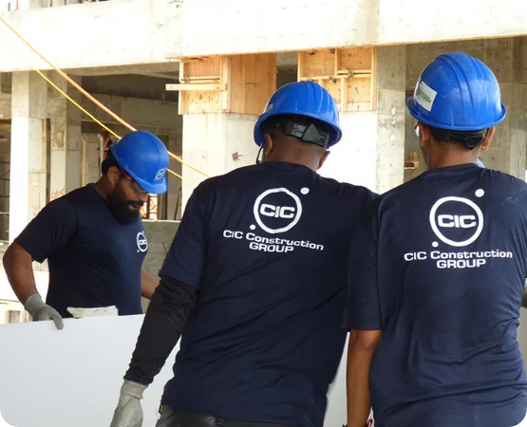
Why they are hard to build
These systems are much more complex than a normal app or website.
They must handle surprises.
They must be perfectly accurate.
They must never stop working.

Slide 6
Managing Dangers
Safe Design: Build the system to be safe from the start.
Find Problems: Look for things that could go wrong.
Lower Risks: Control dangers so they don't cause harm.
Reduce Impact: If a failure happens, make sure the damage is small.

Slide 7
Time and Money
$$$
Building them is a big job:
It takes a very long time to finish.
It costs a huge amount of money because we have to test everything over and over again.
High Investment

Slide 8
The "Careful" Steps
Every step must be done with extreme care:
The Step | What we do
Coding | Writing the software with no mistakes.
Inspection | Having other experts check the work carefully.
Testing | Trying to break it to find any hidden problems.
Verification | Proving that it does exactly what it should.

Slide 9
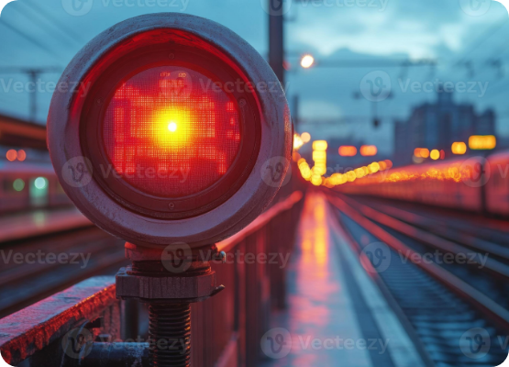
Following Strict Rules
Before these systems can be used in the real world, they must follow strict laws and standards.
They must pass many certifications to prove they are safe for people to use.

Slide 10






Where do we use them?
Defense
Warnings
Hospitals
Missile systems and weapon controls.
Tsunami and Earthquake alarms.
Fire alarms and life-support machines.

Slide 11

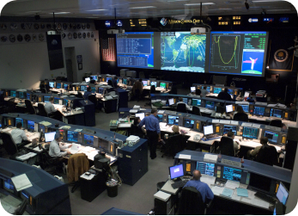

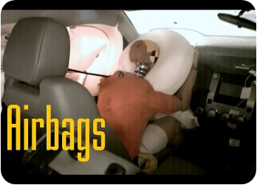

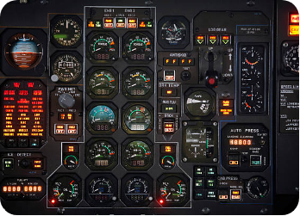
More Examples
Space: Rocket launch and navigation.
Cars: Brakes and Airbag systems.
Planes: Flight control systems.

Slide 12
Summary
Safety-critical systems are built with maximum care because failure is not an option. They require careful design and strict testing to keep us all safe.

Slide 13
Thank You.

